Slide 1
Coursework 1 - Requirements
Optional - Hand draft version Monday Week 8, 19th November via e-mail PhillipsHR@Cardiff.ac.uk
Final Deadline - Wednesday 3rd December 2018 at 9:30am, Via Learning Central

Slide 2
On the bottom of each page of the team portfolio type the name of the members of the team that have contributed to that particular section
 | Description |  | Type | Name
Team Submission | Requirements document including coursework coversheet | Compulsory | One .pdf file | [team number]requirements.pdf
Individual Submission - Team File exchange | Self-Review, and peer reviews for each team member | Compulsory | One PDF | Student_ID&Team.pdf

Slide 3
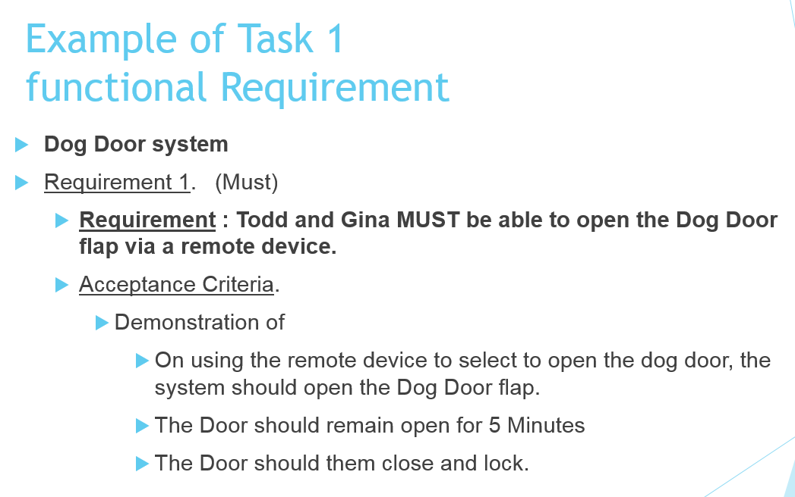
Task 1 - List of Functional User Requirements
Develop a list of functional requirements with brief descriptions indicating the features you would like to provide in your application (see scenario). Requirements should be listed using the MoSCoW notation and be written so that they can be validated / acceptance tested. [these brief descriptions will most likely develop into your use cases]

Slide 4
Task 2 - Use Case Diagram
Develop a Use Case diagram to capture the major functional requirements of the ` Educational Software Test System’ from the client/users’ point of view. Include in the use case diagram any possible relationships between the use cases (namely, include, and extend).
Use-case diagram
Title of the system
Use case 1
Use case 1
Use case 1
Actor 1
Actor 1
Actor 1
Use case 2
Use case 2
Use case 2
Actor 2
Use case 3
Use case 3
Use case 3
Actor 3
Actor 3
Actor 3

Slide 5
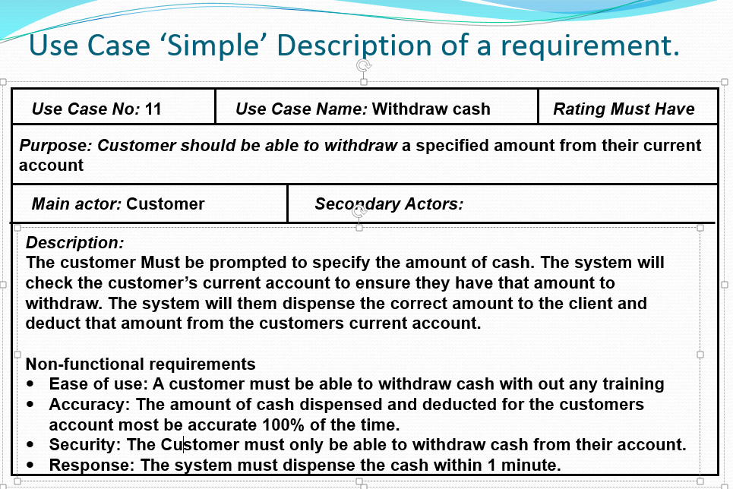
Use Case Description or User Story
For each use case identified, write a use case description or user story. (Each team member should write ONE each). Don’t forget to include the associated non-functional requirements (attributes, constraints or characteristics). These should be written as testable acceptance criteria.

